Slide 1
Real Time AI Systems

Slide 2
Lecture 2a: Asynchronous Programming

Slide 3
Recap: Concurrency v Parallelism
Concurrency in Python:
- Achieved using: threading, asyncio
- Main Idea: Tasks make progress by taking turns (context switching), not by literally executing at the same time.
- Useful for: I/O-bound tasks (e.g., web requests, file I/O)
Python threads don’t run in parallel due to the Global Interpreter Lock (GIL). Instead, they interleave execution.
Concurrency is an approach that is used for decreasing the response time of the system by using the single processing unit. Concurrency creates the illusion of parallelism, however actually the chunks of a task aren't parallelly processed

Slide 4
Recap: Concurrency v Parallelism
Parallelism in Python:
- Achieved using: multiprocessing, Ray or joblib
- Main Idea: Tasks run simultaneously on multiple CPU cores.
- Useful for: CPU-bound tasks (e.g., heavy computation)
- Because multiprocessing creates separate processes, each has its own Python interpreter and avoids the GIL.
- Parallelism is related to an application where tasks are divided into smaller sub-tasks that are processed parallel. It is used to increase the throughput and computational speed of the system by using multiple processors.

Slide 5
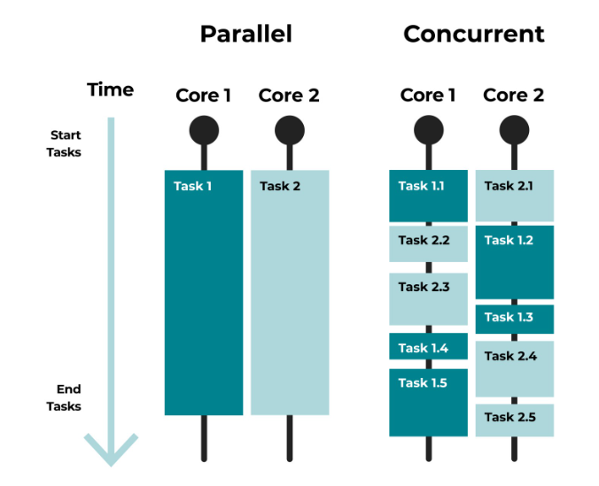
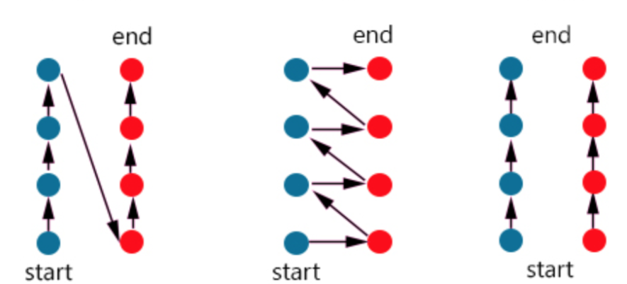
Recap: Concurrency v Parallelism

Slide 6
Recap: Concurrency v Parallelism
Region | Tools | Use Case | Example
✅ Concurrency Only | threading, asyncio | Overlapping I/O | Downloading files concurrently using asyncio
✅ Parallelism Only | multiprocessing, joblib, concurrent.futures.ProcessPoolExecutor | Heavy computation split across CPUs | Processing large arrays in parallel
✅✅ Concurrency & Parallelism (Both) | asyncio + multiprocessing or threads + processes | Fetch data concurrently (I/O), then compute in parallel (CPU) | Scraping pages with asyncio, then parsing with multiprocessing
❌ Neither (Sequential) | None (basic single-threaded execution) | Linear, blocking, single-threaded tasks | A script that processes one file after another

Slide 7
Asynchronous Programming
Chess master Judit Polgár hosts a chess exhibition in which she plays multiple amateur players. She has two ways of conducting the exhibition: synchronously and asynchronously.
Assumptions:
24 opponents Judit makes each chess move in 5 seconds
Opponents each take 55 seconds to make a move Games average 30 pair-moves (60 moves total)
Synchronous version:
Judit plays one game at a time, never two at the same time, until the game is complete. Each game takes (55 + 5) * 30 == 1800 seconds, or 30 minutes. The entire exhibition takes 24 * 30 == 720 minutes, or 12 hours.
Asynchronous version:
Judit moves from table to table, making one move at each table. She leaves the table and lets the opponent make their next move during the wait time. One move on all 24 games takes Judit 24 * 5 == 120 seconds, or 2 minutes. The entire exhibition is now cut down to 120 * 30 == 3600 seconds, or just 1 hour.

Slide 8
Asynchronous Programming
Asynchronous (async) programming in Python is a programming paradigm that allows your program to run concurrent code using async and await syntax, without using threads or processes.
It's especially useful for I/O-bound operations like:
- Network requests - File reading/writing - APIs
- Database access - Web scraping
Core Concepts:
Generators: a function that yields value instead of returning them (paused and resumed)
Coroutines: special generators that can receive values via .send() method
Modern Coroutine (with async def): Don’t run immediately – handled by the event loop

Slide 9
Asynchronous Programming
Core Concepts:
await: Waits for another coroutine to finish
asyncio: Provides tools & loop management
Non-blocking I/O: Doesn’t wait idly – lets other tasks run in the meanwhile
Event loop:
The event loop is the core of Python's asyncio module. As it:
Keeps track of pending coroutines/tasks.
Switches between tasks when one is waiting (e.g., for I/O).
Ensures non-blocking concurrency.

Slide 10
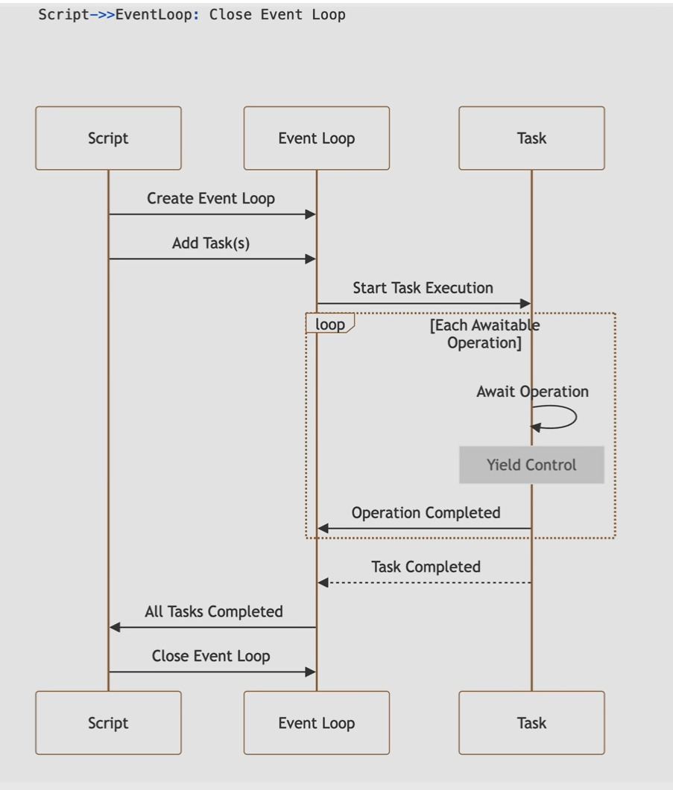
Asynchronous Programming

Slide 11
Asynchronous Programming
Demos:
Generators
Classic Coroutines
Modern Coroutines
Event Loops
Asyncio Run
Sync Server
Async Server
Async Controlled Flow

Slide 12
Asynchronous Programming
Use Case | Async Library
Web APIs | aiohttp, httpx
DBs | asyncpg, aiomysql
File I/O | aiofiles
Web servers | FastAPI, uvicorn
Queueing | aiokafka, aio-pika

Slide 13
Asynchronous Programming
Feature | threading | asyncio
Overhead | Medium (real OS threads) | Low (coroutines in one thread)
Memory usage | Higher | Lower
Ideal for | I/O-bound w/ blocking libraries | I/O-bound w/ async-compatible libraries
CPU-bound tasks | ❌ GIL-bound | ❌ Same limitation
Debugging | Hard | Easier stack traces

Slide 14
Asynchronous Programming
Feature/Aspect | threading | multiprocessing | asyncio
Type | Concurrency | Parallelism | Concurrency
GIL Impact | ❌ Affected (1 thread at a time) | ✅ Bypassed (separate processes) | ❌ Affected (single thread)
Use case type | I/O-bound | CPU-bound | I/O-bound, high throughput
Parallel execution? | ❌ No | ✅ Yes | ❌ No
Memory sharing | ✅ Shared memory | ❌ No (copy between processes) | ✅ Shared memory
Overhead | Medium (real threads) | High (process setup/copying) | Low (coroutines)
Code complexity | Low–Medium | Medium | Medium
Debuggability | Harder (races) | Moderate | Easier w/ stack traces
Blocking behavior | Blocking I/O | Runs independently | Non-blocking
Good for AI/LLM use cases | ✅ Data loading, scraping | ✅ Preprocessing, scoring | ✅ Async APIs, serving, streaming

Slide 15
Asynchronous Programming
Task | Best Tool | Why
Loading large files or web scraping | threading | I/O-heavy, runs while waiting
Parallelizing CPU-heavy data cleaning | multiprocessing | Multiple cores, bypass GIL
Calling async inference APIs | asyncio | Highly scalable, non-blocking
Running batch model inference in parallel | multiprocessing | Fully parallel execution
Serving streaming LLM responses | asyncio | Keeps connection open, non-blocking
Fetching embeddings from external APIs | asyncio | Latency hiding, lightweight
Running long tasks in the background | threading | Simple, no extra memory

Slide 16
Overview
Is it I/O-bound?
/ \
Yes No
/ \
Can you use async? Is it CPU-heavy?
/ \ / \
Yes No Yes No
(asyncio) (threading) (multiprocessing) (Sequential)

Slide 17
Async Servers

Slide 18
Assignment 2a
What You’ll Do:
Pick any 3 public APIs— maybe to get weather, names, space data, etc.
Pick any 3 simple websites — like a news site, blog, or reference page.
Fetch data from APIs (parse the JSON)
Scrap basic page info (like titles, headings, or paragraphs)
Do it all concurrently using `asyncio` module, control the flow such that first three websites are scraped and then three API calls
Output:
Cleanly print API and scraping results
Show how long it took (benchmark the total time)
Bonus (if you want to stretch):
Try a sequential version and compare speed
Handle failures gracefully

Slide 19

Assignment 2b
What You’ll Do:
Download/Install Ollama (LLM Inference Platform)
Download Qwen 3 4B LLM model in Ollama
Serve with Concurrency enabled
Benchmark concurrency of the system
This is a guided assignment, aimed to give exposure to the state of the art concurrent system
Utilize python asyncio package

Slide 20
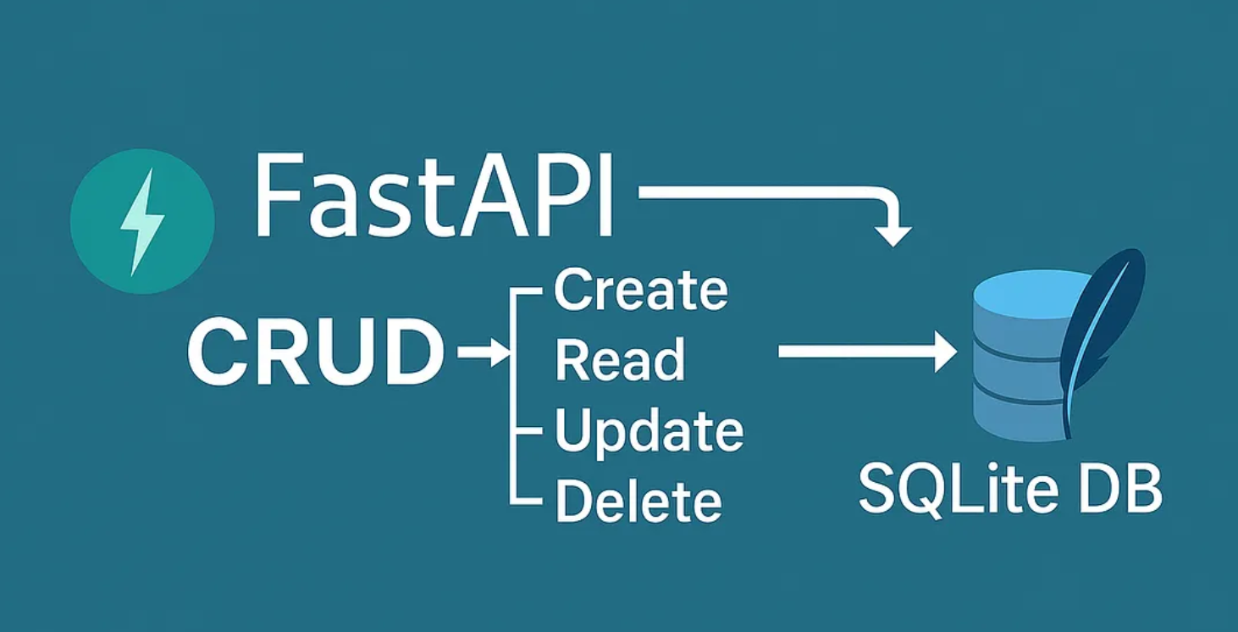
Assignment 3
Problem Statement:
Async CRUD App – Albums, Movies, and Books
Objective:
You are tasked with building a fully asynchronous CRUD web application using FastAPI and aiosqlite. The app will manage three distinct categories of media:
- Books: title, author
- Movies: title, director
- Albums: title, artist
Your goal is to design a clean, modular, and robust RESTful API that supports full Create, Read, Update, and Delete (CRUD) operations for each category.
Functional and Optional Requirements can be found in the document shared.

Slide 21
Questions?

